Slide 1
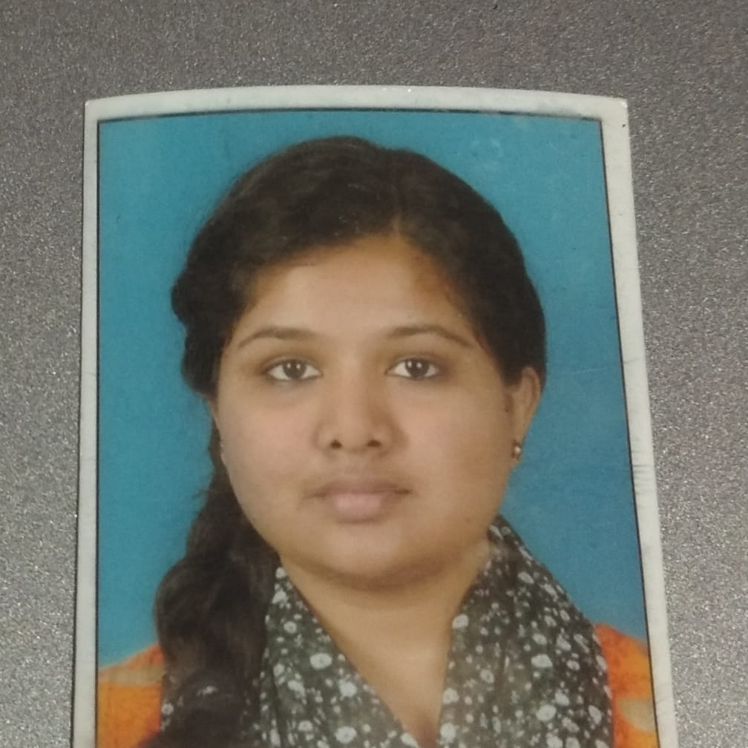



Manasa B V
Analyst/Software Engineer
Bachelor of Technology
Computer Science : 2016 - 2020
Skills
Java 8 /J2EE
Spring Boot
Spring Microservice
Database
SQL database – MySQL
No SQL database – MongoDB
Web Technologies
HTML5
CSS3
JavaScript
Angular
AddOns
Github
Maven
Postman
Swagger API
Additional Details
Leadership
Quick Learner
Team management
Bangalore
MANASA.B-V@CAPGEMINI.COM
9019520231
A4
Software Engineer who is Strong in design and integration with intuitive problem-solving skills. Passionate about implementing and launching new projects.
Ready to learn new technologies and implement them to further improve my knowledge.
Eager to work in a team of dedicated people and serve a key role in the enhancement and development of the project.
Has working knowledge on Angular and Java Microservice Development using Spring framework on an intermediate level.
https://github.com/manasa9480/Profile
https://github.com/manasa9480/case-study-video/blob/main/AgricultureCropSystem.mp4
Agriculture Crop system
Completed end to end case study of Agriculture crop system
along with JWT authentication, Swagger and payment testing using Braintree in MERN Stack. Material-UI and React Bootstrap used for user interface.
HTML CSS JAVASCRIPT for web developers at Coursera
Completed this course with 98.6% and Designed responsive Restaurant website using HTML5 CSS3 Bootstrap and Javascript
Check out my work on GitHub & Video Profile

